Slide 1
CSS-448 - Introduction to Compilers
IR - Intermediate Representation
Intermediate Representations
AST
DAG
Linear
Control Flow Graph (CFG)
Introduction to Compilers : IR
<number>
Notes:
<number>

Slide 2
Reminder : Compiler Phases
Introduction to Compilers : IR
<number>

Slide 3
Compiler Phases
BackEnd
chars
Lexer
tokens
Parser
AST
Semantic
Checker
AST
AST to IR
IR
source
target
Above was original picture of a compiler. In reality, “Backend" comprises many sub-phases:
AST
AST to IR
Control Flow Analysis
Convert IR to x86
Register Allocator
Instruction
Scheduler
Emit Assembly Code
Assemble
Link
target
Introduction to Compilers : IR
<number>

Slide 4
Compiler Backend Phases
AST
AST to IR
Control Flow Analysis
Convert IR to x86
Register Allocator
Emit Assembly Code
AST to IR
Walk the AST and generate IR
Control Flow Analysis
Optimize the code to make it run faster. This step alone may comprise dozens of sub-phases
Convert IR to x86
Like is says
Register Allocator
Make best use of all available registers
Emit Assembly Code
Emit text file, to feed into Assembler
Introduction to Compilers : IR
<number>

Slide 5
Intermediate Reps
Introduction to Compilers : IR
<number>

Slide 6
Intermediate Representations
In most compilers, the parser builds an AST, then constructs an Intermediate Representation (IR) of the program
“intermediate” => between source & target; or between frontend and backend
Rest of the compiler transforms the IR to improve (“optimize”) it; eventually translate to final code
Sometimes use multiple forms of IR on the way
Eg: Muchnick’s HIR, MIR, LIR (“lowering”)
Choosing the 'right' IR is critical
Introduction to Compilers : IR
<number>
Notes:
<number>

Slide 7
IR Design
Decisions affect speed and efficiency of the compiler. Difficult to change later
Desirable properties
Easy to generate
Easy to manipulate, for analysis and transformations
Expressive
Appropriate level of abstraction
Efficient & compact (memory footprint; cache performance)
Different tradeoffs depending on compiler goals
eg: Throughput versus Code Quality
Different tradeoffs in different parts of the same compiler
Introduction to Compilers : IR
<number>
Notes:
<number>
Au02: taken from Cooper’s slides

Slide 8
IR Design Taxonomy
Structure
Graphical (trees, DAGs, etc)
Linear (code for some abstract machine)
Hybrids are common (eg: Flowgraphs)
Abstraction Level
High-level, near to source language
Low-level, closer to machine
Introduction to Compilers : IR
<number>

Slide 9
Levels of Abstraction
Key design decision: how much detail to expose
Affects possibility and profitability of various optimizations
Structural IRs are typically fairly high-level
Linear IRs are typically low-level
Introduction to Compilers : IR
<number>

Slide 10
Examples: Array Reference
Assume A is char array dimensioned [1..9, 1..9]
Array is stored in column-major form; ie column-by-column
FortranSource
A[i, j]
11 | 12 | 13 | 14 | 15 | 16 | 17 | 18 | 19
21
31
41
51
61
71
81
91 |  |  |  |  |  |  |  | 99
subscript
AST
A
i
j
High-level, linear IR
Address of A[i, j] is:
&A[1,1] + (j – 1) * 9 + (i – 1)
t1 = A[i, j]
Introduction to Compilers : IR
<number>
Notes:
<number>
Au02: still borrowing from Cooper’s slides

Slide 11
Examples: Array Reference : r9 = A[i, j]
Medium-level, linear IR
load Immediate
loadI 1 => r1
sub rj, r1 => r2
loadI 9 => r3
mul r2, r3 => r4
sub ri, r1 => r5
add r4, r5 => r6
loadI @A => r7
add r7, r6 => r8
load r8 => r9
i is in ri (register i)
j is in rj (register j)
subtract
j - 1
multiply
9 * (j – 1)
i - 1
What is a register?
add
9 * (j – 1) + (i – 1)
How to change if A held floats?
load value from address in R8
r9 = A[i, j]
This is IR is still “medium level”. Why?
allows unlimited number of registers (r1, ...)
supports symbolic registers. Eg: ri, rj
Introduction to Compilers : IR
<number>
Notes:
<number>
Au02: still borrowing from Cooper’s slides

Slide 12
Where are values stored?
CPU Registers
Typically 16 x 64-bit
Access time ~1 nsec
Cache
Typically 3 MB
Access Time ~10 nsec
Memory (RAM)
Typically 8 GB
Access Time ~ 150 nsec
Disk
Typically 1 TB
Non-Volatile
Access Time ~10 msec
02/21/2020
CSS430 Operating Systems : Memory
<number>

Slide 13
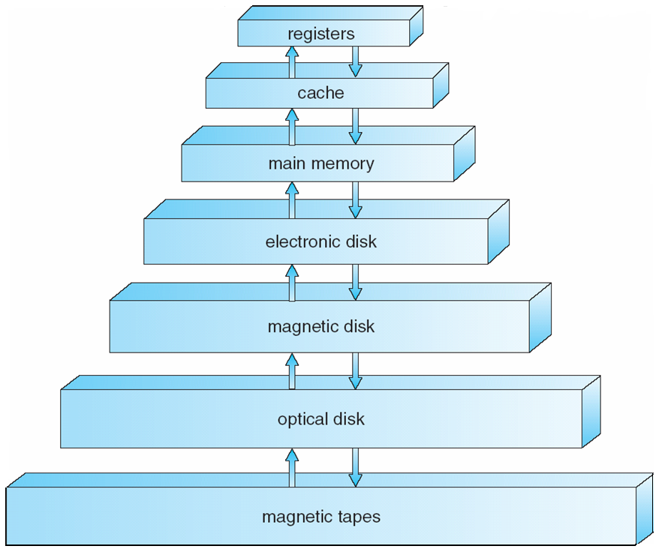
Storage-Device Hierarchy
Human
Scale
1 nano-sec
1 sec
10 nano-secs (L2)
150 nano-secs
100 micro-secs
1 day
10 milli-secs
4 months
minutes!
2 years

Slide 14
Structural IRs
Typically reflect source (or other higher-level) language structure
Tend to be large - all those grammar NonTerminals
Examples: syntax trees, DAGs
Generally used in early phases of compilers
Introduction to Compilers : IR
<number>
Notes:
<number>
Au02: based on Cooper’s slides

Slide 15
Concrete Syntax Trees
Also called “Parse Trees”
Useful for IDE; syntax coloring; refactoring; source-to-source translation (which also, retains comments)
Full grammar is needed to guide the parser; but once parsed, we don’t need:
NonTerminals used to define associativity & precedence (recall E, T, F in Expression Grammar)
NonTerminals for every production
Punctuation, such as ( ) { } - these help us express a tree structure in linear text format (consider XML and LISP)
Introduction to Compilers : IR
<number>

Slide 16
Syntax Tree Example
A => id = E
E => E + T | E – T | T
T => T × F | T ÷ F | F
F => int | id | ( E )
Concrete syntax for x = 2 * ( n + m );
Draw the Parse Tree for the above assignment
Draw the Syntex Tree (AST) for the above assignment
Introduction to Compilers : IR
<number>

Slide 17
Parse Tree: x = 2 × (m + n)
A => id = E
E => E + T | E – T | T
T => T × F | T ÷ F | F
F => int | id | ( E )
A
id
=
E
Denotes a node that survives into the AST
T
x
T
×
F
F
(
E
)
=
int
E
+
T
x
×
2
T
F
2
+
F
id
id
m
n
n
m
Introduction to Compilers : IR
<number>
Notes:
<number>

Slide 18
Abstract Syntax Trees
Want only essential structural information
Omit extraneous junk
Can be represented explicitly as a tree or in a linear form
Example: LISP/Scheme S-expressions are essentially ASTs
Common output from parser
Used for static semantics (type checking, etc) and high-level optimizations
Usually lowered for later compiler phases
What does “lowered” mean?
Introduction to Compilers : IR
<number>

Slide 19
Lisp == AST of Prefix Expressions
(+ 2 3)
+
(+ (* 2 3) 8)
Draw the AST for this expression
*
+
8
2
3
(= 10 (+ 4 6))
The expressions are written in Scheme – a tidy variant of List
Introduction to Compilers : IR
<number>

Slide 20
A => id = E
E => E + T | E – T | T
T => T × F | T ÷ F | F
F => int | id | ( E )
Parse Tree & AST
A
Parse Tree
id
=
E
x = 2 × (m + n)
T
Abstract Syntax Tree
x
=
T
×
F
id:x
×
F
(
E
)
int:2
+
int
E
+
T
id:m
id:n
2
T
F
F
Think of each box as a C struct
id
id
n
m
Introduction to Compilers : IR
<number>
Notes:
<number>

Slide 21
DAGs
Introduction to Compilers : IR
<number>

Slide 22
DAG : Directed Acyclic Graph
DAGs often used to identify common sub-expressions (CSEs)
Not necessarily a primary representation, compiler might build dag then translate back after some code improvement
Leaves = operands
Interior nodes = operators
Introduction to Compilers : IR
<number>

Slide 23
Expression DAG example
DAG for a + a * (b – c) + (b – c) * d
Draw the AST for the above Expression
Introduction to Compilers : IR
<number>

Slide 24
AST for : a + a * (b – c) + (b – c) * d
+
+
id:a
×
×
id:a
-
-
id:d
id:b
id:c
id:b
id:c
Duplicated Nodes
Introduction to Compilers : IR
<number>

Slide 25
DAG for : a + a * (b – c) + (b – c) * d
+
+
'Folded' AST or DAG
Original AST
+
+
id:a
×
×
id:a
×
×
id:a
-
-
id:d
id:a
-
id:d
id:b
id:c
id:b
id:c
id:b
id:c
When we come to generate code (compiler) or evaluate (interpreter), we will process the blue nodes only once. Example of Constant Sub-Expression Elimination (CSE)
Introduction to Compilers : IR
<number>

Slide 26
Linear IRs
Introduction to Compilers : IR
<number>

Slide 27
Linear IRs
Pseudo-code for some abstract machine
Level of abstraction varies
Eg: t ← a[i, j] – High Level
Eg: no registers, just variables & temps
Cf: @a + 4 * (i * numcols + j) – Low Level (0-based index)
Simple, compact data structures
Commonly used: arrays, linked lists
Examples
Three-Address Code (TAC) – ADD t123, b, c
Stack machine code – push a; push b; add
Introduction to Compilers : IR
<number>

Slide 28
IRs for a[i, j+2]
High-level
a[i, j+2]
Medium-level
t1 ← j + 2
t2 ← i * 20
t3 ← t1 + t2
t4 ← 4 * t3
t5 ← addr a
t6 ← t5 + t4
t7 ← *t6
Low-level
r1 ← [fp-4]
r2 ← r1 + 2
r3 ← [fp-8]
r4 ← r3 * 20
r5 ← r4 + r2
r6 ← 4 * r5
r7 ← fp – 216
f1 ← [r7+r6]
Akin to source code
Spells out 2-D indexing. Defines temps - like virtual registers
Full detail
Actual machine registers
Actual locations (no variable names)
Introduction to Compilers : IR
<number>
Notes:
<number>

Slide 29
Abstraction Level Tradeoffs
High-level: good for source optimizations; semantic checking; refactoring
Medium-level: great for machine-independent optimizations. Many optimizing compilers work at this level
Low-level: required for actual memory (frame) layout; target instruction selection; register allocation; peephole (target-specific) optimizations
Examples:
Cooper&Torczon "ILOC"
LLVM - http://llvm.org
SUIF - http://suif.stanford.edu
Introduction to Compilers : IR
<number>

Slide 30
Three-Address Code (TAC)
Usual form: x ← y op z
One operator
Maximum of 3 names
(Copes with: nullary x ← y and unary x ← op y)
Eg: x = 2 * (m + n) becomes
t1 ← m + n; t2 ← 2 * t1; x ← t2
You may prefer: add t1, m, n; mul t2, 2, t1; mov x, t2
Invent as many new temp names as needed. “expression temps” – don’t correspond to any user variables; ‘anonymous’ variables
Store in a quad(ruple)
<lhs, lhs, op, rhs>
Introduction to Compilers : IR
<number>

Slide 31
Three Address Code
Advantages
Resembles code for actual machines
Explicitly names intermediate results
Compact
Often easy to rearrange
Various representations
Quadruples, triples, SSA (Static Single Assignment)
We will see much more of this…
Introduction to Compilers : IR
<number>

Slide 32
Stack Machine Code Example
Hypothetical code for x = 2 * (m + n)
pushaddr x
pushconst 2
pushval n
pushval m
add
mult
store
m
n
m + n
2
2
2*(m+n)
@x
@x
@x
?
?
?
?
Compact: common opcodes just 1 byte wide; instructions have 0 or 1 operand
Introduction to Compilers : IR
<number>

Slide 33
Stack Machine Code
Originally used for stack-based computers (famous example: B5000, ~1961)
Also now used for virtual machines:
UCSD Pascal – pcode
Forth
Java bytecode in a .class files (generated by Java compiler)
MSIL in a .dll or .exe assembly (generated by C#/F#/VB compiler)
Advantages
Compact; mostly 0-address opcodes (fast download over network)
Easy to generate; easy to write a FrontEnd compiler, leaving the 'heavy lifting' and optimizations to the JIT
Simple to interpret or compile to machine code
Disadvantages
Inconvenient/difficult to optimize directly
Does not match up with modern chip architectures
Introduction to Compilers : IR
<number>

Slide 34
Hybrid IRs
Combination of structural and linear
Level of abstraction varies
Most common example: control-flow graph
Nodes: basic blocks
Edge from B1 to B2 if execution can flow from B1 to B2
Introduction to Compilers : IR
<number>

Slide 35
Control Flowgraph : Intro
Introduction to Compilers : IR
<number>

Slide 36
Basic Blocks: Starting Tuples
1 i = 1 2 j = 1 3 t1 = 10 * i 4 t2 = t1 + j 5 t3 = 8 * t2 6 t4 = t3 - 88 7 a[t4] = 0 8 j = j + 1 9 if j <= 10 goto #3 | 10 i = i + 1 11 if i <= 10 goto #2 12 i = 1 13 t5 = i - 1 14 t6 = 88 * t5 15 a[t6] = 1 16 i = i + 1 17 if i <= 10 goto #13
Typical "tuple stew" - IR generated by traversing an AST
Identify the Leaders – instructions that being a Basic Block
Partition into Basic Blocks:
Sequence of consecutive instructions
No jumps into the middle of a BB
No jumps out of the middles of a BB
"I've started, so I'll finish"
(Ignore exceptions)
How many loops in this fragment?
Introduction to Compilers : IR
<number>

Slide 37
Basic Blocks: Leaders
1 i = 1 2 j = 1 3 t1 = 10 * i 4 t2 = t1 + j 5 t3 = 8 * t2 6 t4 = t3 - 88 7 a[t4] = 0 8 j = j + 1 9 if j <= 10 goto #3 | 10 i = i + 1 11 if i <= 10 goto #2 12 i = 1 13 t5 = i - 1 14 t6 = 88 * t5 15 a[t6] = 1 16 i = i + 1 17 if i <= 10 goto #13
Identify Leaders (first instruction in a basic block):
First instruction is a leader
Any target of a branch/jump/goto
Any instruction immediately after a branch/jump/goto
Leaders in red. Why is each leader a leader?
Introduction to Compilers : IR
<number>

Slide 38
ENTRY
Basic Blocks: Flowgraph
B1
i = 1
B2
j = 1
Control Flow Graph ("CFG", again!)
B3
t1 = 10 * i
t2 = t1 + j
t3 = 8 * t2
t4 = t3 - 88
a[t4] = 0
j = j + 1
if j <= 10 goto B3
3 loops total
2 of the loops are nested
B4
i = i + 1
if i <= 10 goto B2
B5
i = 1
B6
t5 = i - 1
t6 = 88 * t5
a[t6] = 1
i = i + 1
if i <= 10 goto B6
Most of the executions likely spent in loop bodies; that's where to focus efforts at optimization
Introduction to Compilers : IR
<number>
EXIT

Slide 39
Basic Blocks: Recap
A maximal sequence of instructions entered at the first instruction and exited at the last
So, if we execute the first instruction, we execute all of them
No jumps/branches into the middle of a BB
No jumps/branches out of the middle of a BB
We are ignoring exceptions!
Introduction to Compilers : IR
<number>

Slide 40
Identifying Basic Blocks: Recap
Perform linear scan of instruction stream
A basic blocks begins at each instruction that is:
The beginning of a function/method
The target of a branch
Immediately follows a branch or return
Introduction to Compilers : IR
<number>

Slide 41
What IR to Use?
Common choice: all of them!
AST used in early stages of the compiler
Closer to source code
Good for semantic analysis
Facilitates some higher-level optimizations, such as CSE - altho' this can be done equally well on linear IR
Lower to linear IR for optimization & codegen
Closer to machine code
Use to build control-flow graph
Exposes machine-related optimizations
Hybrid (graph + linear IR) for dataflow
Introduction to Compilers : IR
<number>

